Slide 1

Using Data Science to Understand Data Science:
A Canada-U.S. Comparison of the Labour Market
by Pierre-Olivier Bonin

Slide 2

Introduction
What is the state of the data science labour market, specifically in Canada and the United States?
Are there distinctive features for each of those two markets?

Slide 3
The Data
Survey conducted in 2019 (October 8th to 28th)
Total of 19 717 respondents from 171 countries
Subsamples:
2489 American data science professionals
355 Canadian data science professionals

Slide 4
The Data
1 target variable: country (U.S. / Canada)
10 predictors:
Age
Gender
Education
Job title
Company size
Data science team size
Incorporation of machine learning methods
Salary (annual)
Primary tool used
Number of years using machine learning methods

Slide 5
Methodology
Preprocessing:
Relabelling columns
Selecting features of interest
Dropping row containing question labels
Reformatting features of interest
E.g.: transforming some categorical variables into ordinal variables
Selecting a sub-sample from the total sample
Dealing with missing values

Slide 6
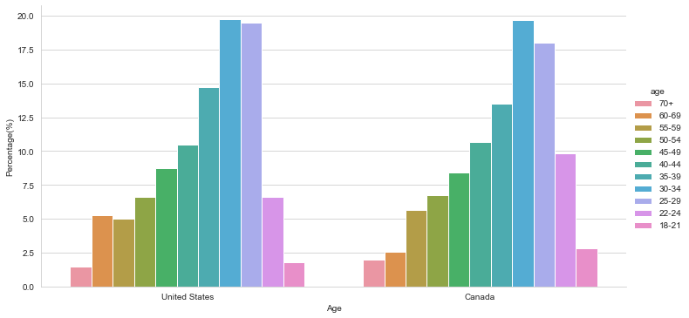
Results: Exploratory Data Analysis (EDA)

Slide 7
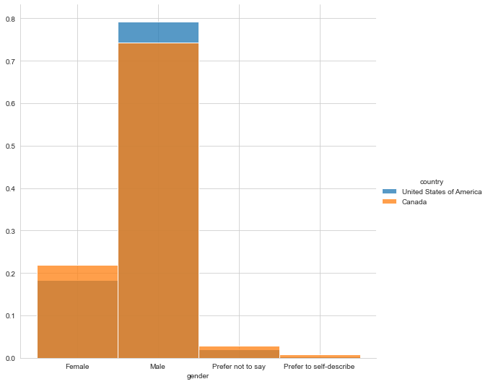
Results: Exploratory Data Analysis (EDA)

Slide 8
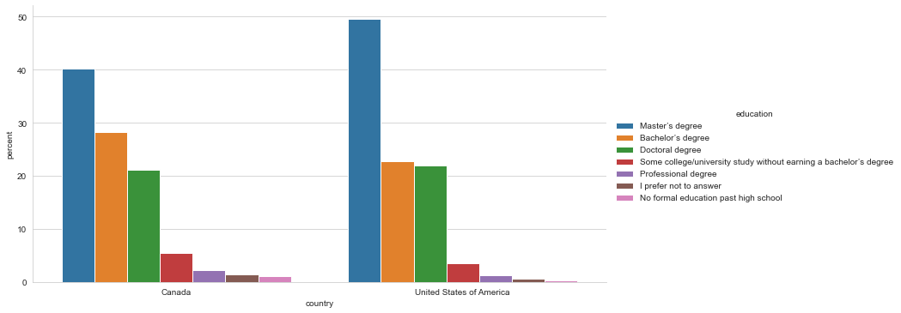
Results: Exploratory Data Analysis (EDA)

Slide 9
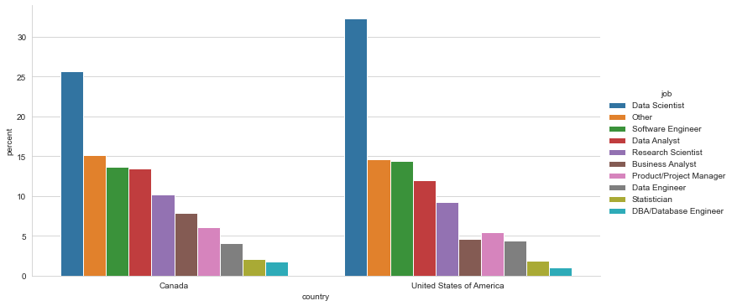
Results: Exploratory Data Analysis (EDA)

Slide 10
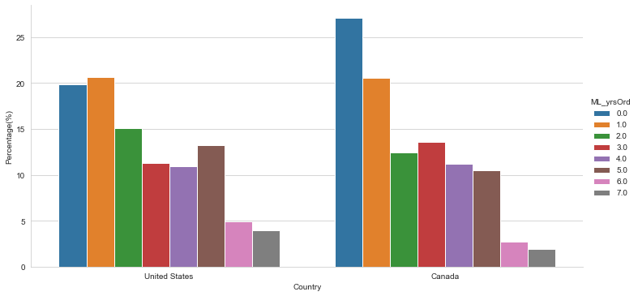
Results: Exploratory Data Analysis (EDA)

Slide 11
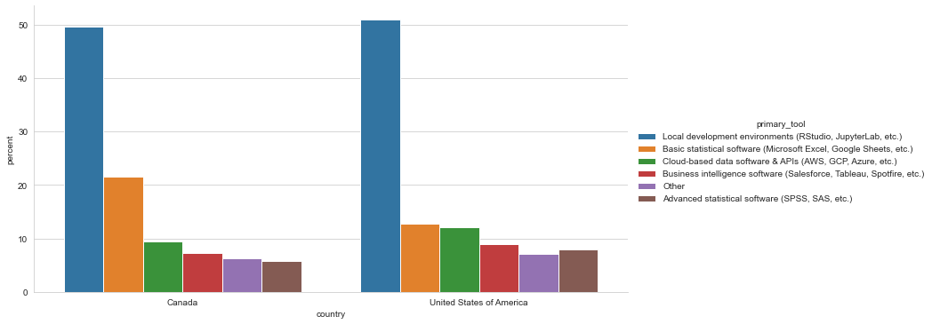
Results: Exploratory Data Analysis (EDA)

Slide 12
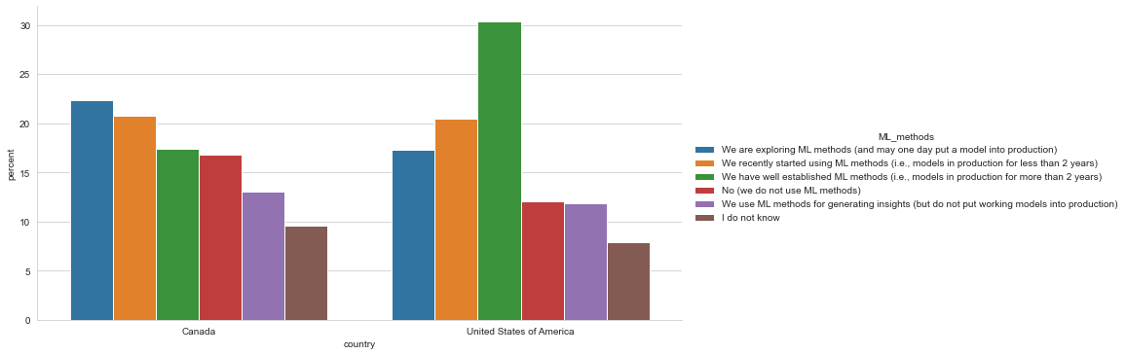
Results: Exploratory Data Analysis (EDA)

Slide 13
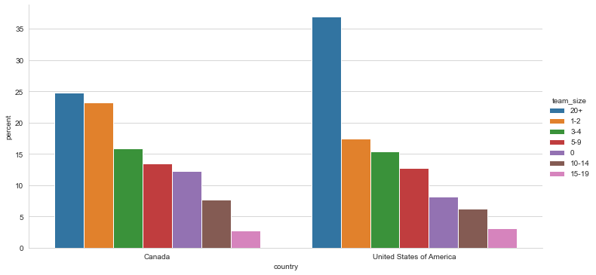
Results: Exploratory Data Analysis (EDA)

Slide 14
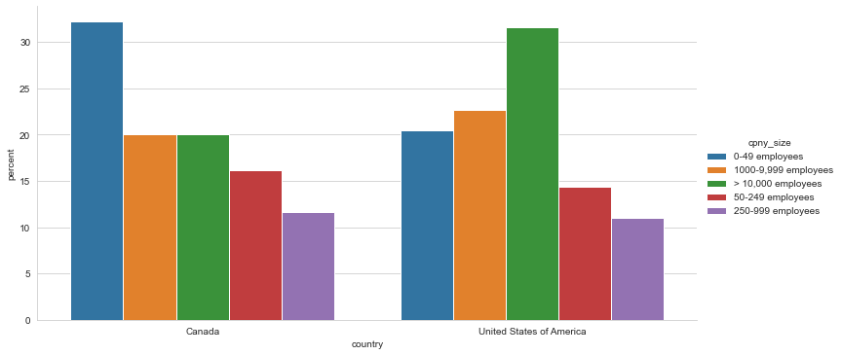
Results: Exploratory Data Analysis (EDA)

Slide 15
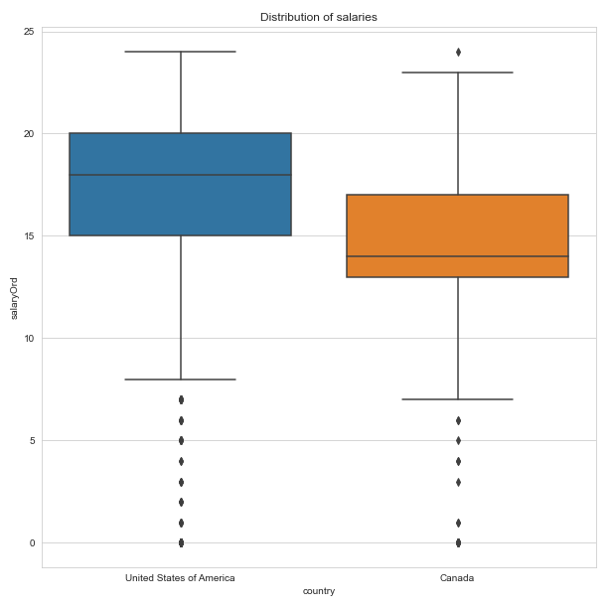
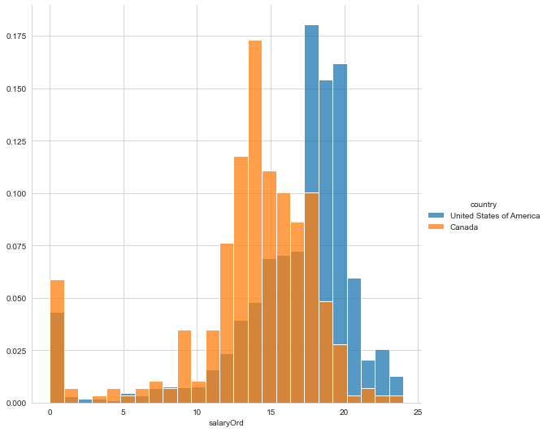
Results: Exploratory Data Analysis (EDA)

Slide 16
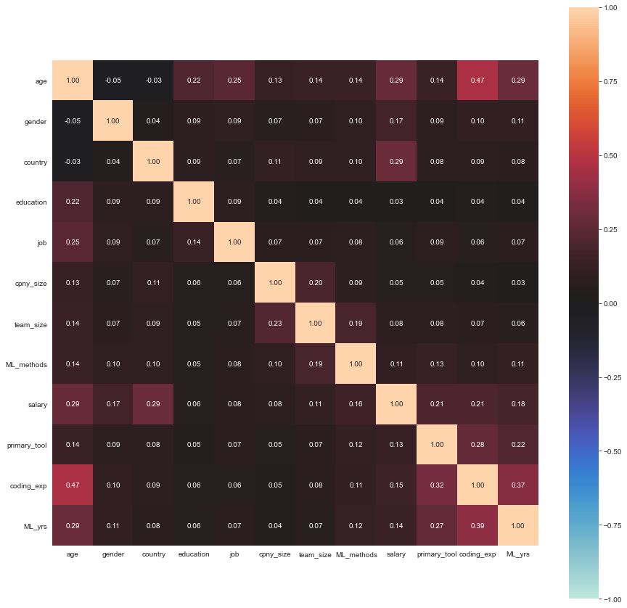
Results: Exploratory Data Analysis (EDA)

Slide 17
Results: Modeling and Evaluation
Model | Accuracy (F-1, weighted average) | LogLoss
Logistic Regression | 0.8488 | 0.3216
K-Nearest Neighbour | 0.8563 | N/A
Decision Tree | 0.8499 | N/A
Support Vector Machine | 0.8510 | N/A

Slide 18
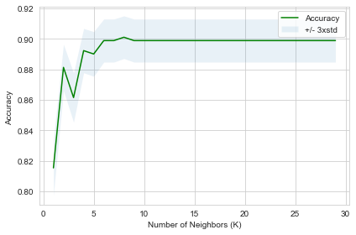
Results: Modeling and Evaluation

Slide 19
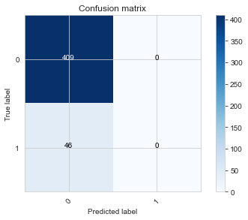
Results: Limitations

Slide 20
Discussion & Recommendations
Differences:
Job titles
Company size
Team size
Years of experience with machine learning
Machine learning maturity level of the company
Primary tool used
Education level
Salary
Age
No difference: gender

Slide 21
Discussion & Recommendations
Models:
Good accuracy, but
Poor performance in predicting whether respondents were Canadian.
Further research required:
Better models?
Survey data from non-Kagglers?

Slide 22
Conclusions: Benefits &Future Deployment Opportunities
Useful for many stakeholders:
Recruiters
Prospective candidates
Company executives
Current employees
Future directions: webscraping job postings on social media?

